Slide 1
Securing SDN

Slide 2
Software Defined Networking (SDN)
Networking devices have two sides of operation
Control (management)
Data (user data)
Agile
Changes can be made rapidly

Slide 3
Software Defined Networking (SDN)
Centrally managed
Global view
Programmatically configured
Orchestration
No human intervention
Open standards/Vendor agnostic
Standard interface to the network

Slide 4
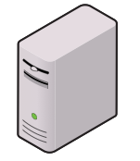



SDN security
Easy to reconfigure
Internet

Slide 5
SDN security
with click of the mouse
Internet

Slide 6

SDN security
…whatever the need is.
Internet

